Slide 1
Austin CTO Summit 2019
I Don’t Read Books Guiding Principles for Building a Leadership Style
Jack Humphrey
VP Engineering, Indeed
@youknowjack | http://jackhumphrey.me
Notes:
Hi there. I’m Jack, and I am here to talk about how I’ve developed guiding principles for building my leadership style. Also, “I Don’t Read Books.”

Slide 2
What? Why?
Notes:
Wait, what? I don’t read books? Why would I stand up here and admit that?

Slide 3
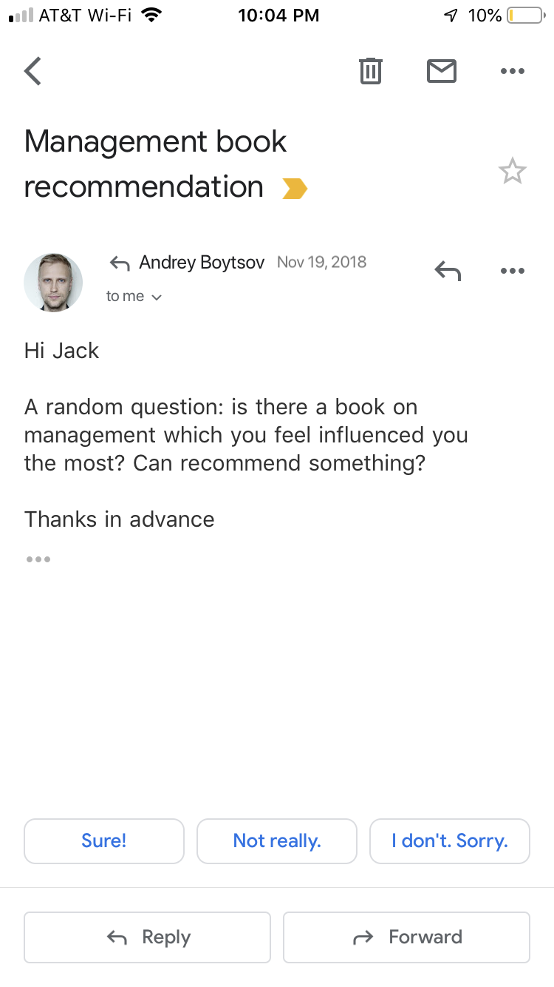
Place screenshot here
...is there a book on management which you feel influenced you the most?
Notes:
It all started with an email I got in November from a manager I add been working with.
This manager asked, “is there a book on management which you feel influenced you the most? Can recommend something?”
You’d think that, in all the years I’ve been coaching engineering managers, I would have gotten this before. But I’m not sure I had. And I was pretty taken aback.

Slide 4
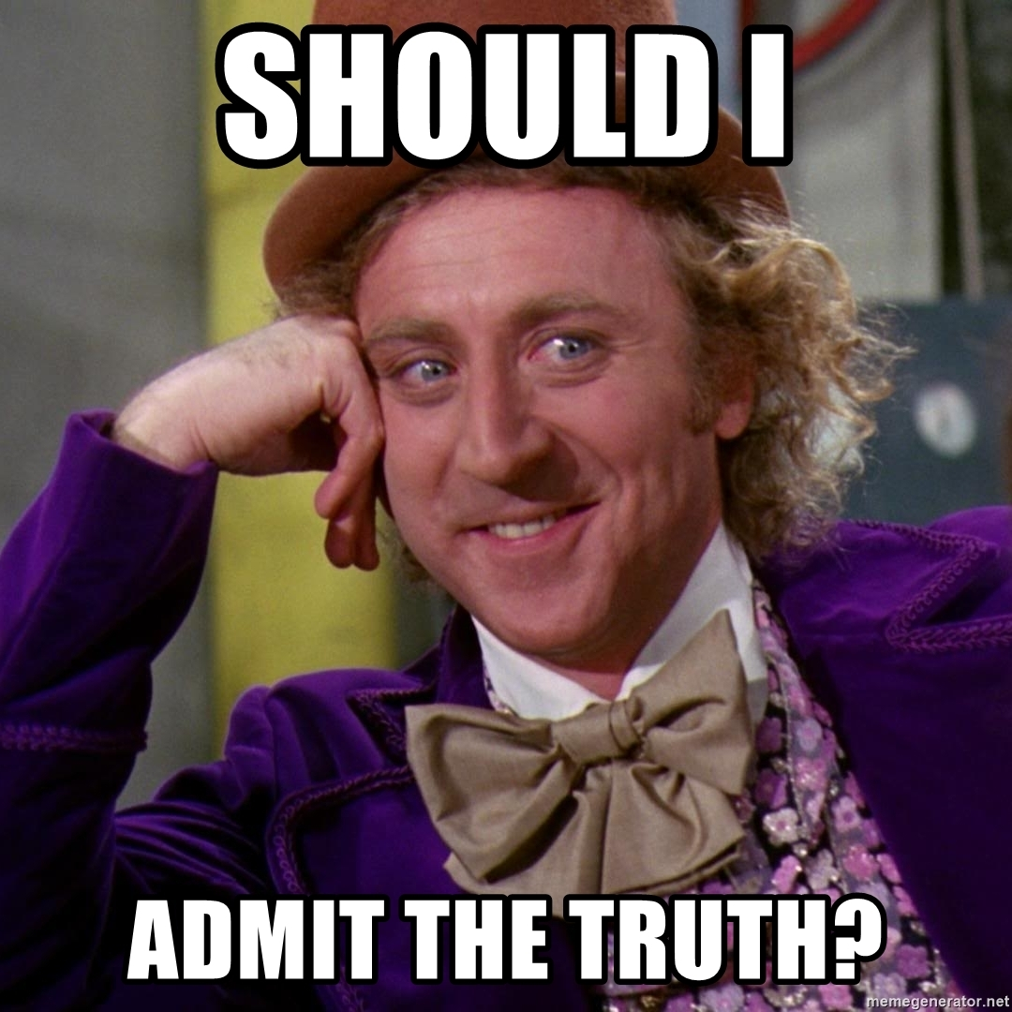
Notes:
...because I had to decide whether or not to admit the truth -- that I didn’t have an answer for this question. There was no book that influenced me the most.
I have some books on management and leadership, and started quite a few more, but that wasn’t really how I developed as a leader.

Slide 5

“
Not really. I've been more influenced by people than books. Role models, mentors, etc.”
I ADMITTED THE TRUTH...
@youknowjack
Notes:
So I decided to be honest. I started writing a response saying, that no book had influenced me as much as people had — my mentors, role models, and colleagues.
I went on to explain how I tend to process the key ideas from leadership books through my own intuitive understanding.

Slide 6
12 examples of techniques in my leadership toolkit, e.g.
“Focus on removing roadblocks”
“Ask questions: prefer a question to a statement”
AND I SHARED SOME THOUGHTS...
@youknowjack
Notes:
And I started listing techniques I had added to my leadership toolkit over the years. Techniques I had picked up mostly from coaches, role models, and the occasional book.
I stopped making the list after the first 12 that came to mind.
They were pretty straightforward things like, “focus on removing roadblocks” and “ask questions”. Things that are easy to say, but hard to do sometimes.

Slide 7
“
I’m still learning…
I have my own blindspots, still.”
AND I ADDED DISCLAIMERS
@youknowjack
Notes:
And then I added some disclaimers.

Slide 8

Then I recommended some reading.
Full response: jackhumphrey.me/lead
Notes:
And after all that, I actually recommended a couple of things to read.

Slide 9
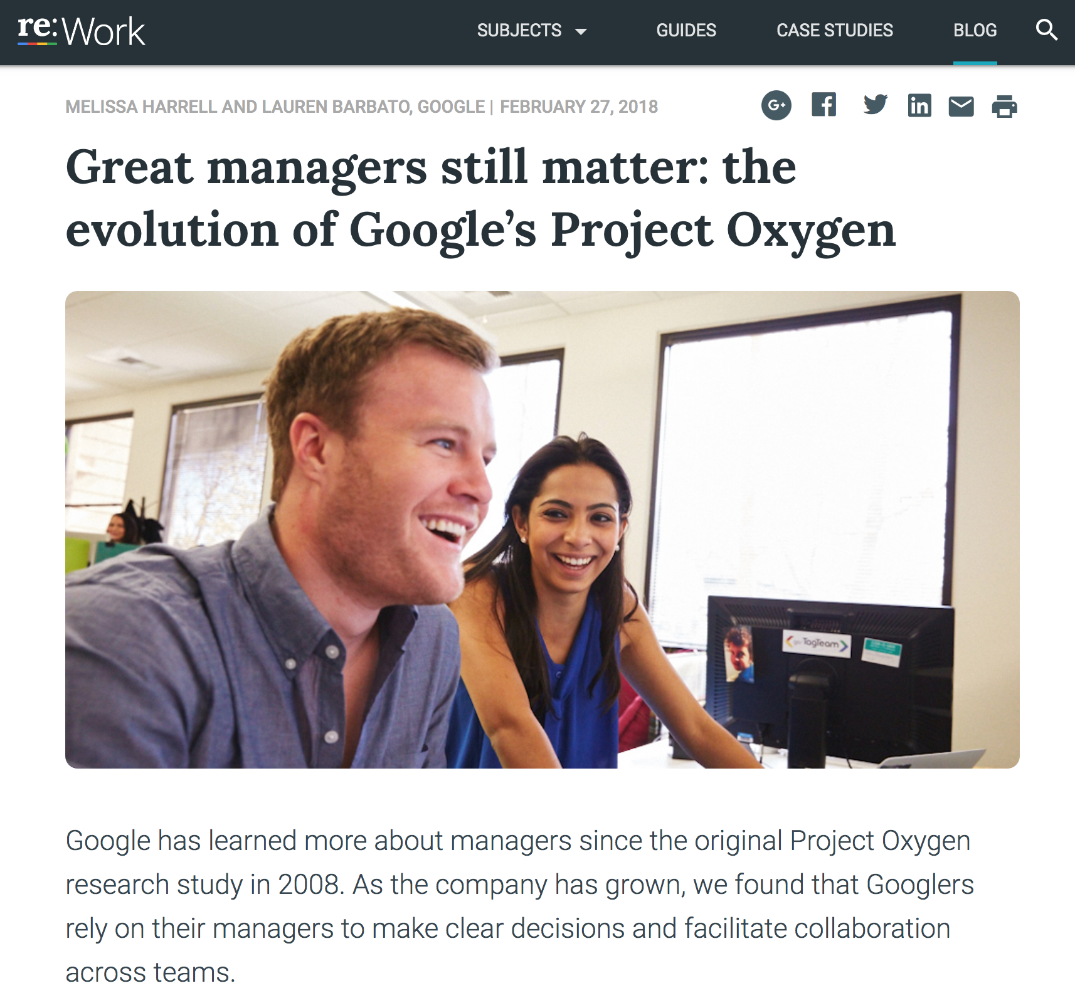
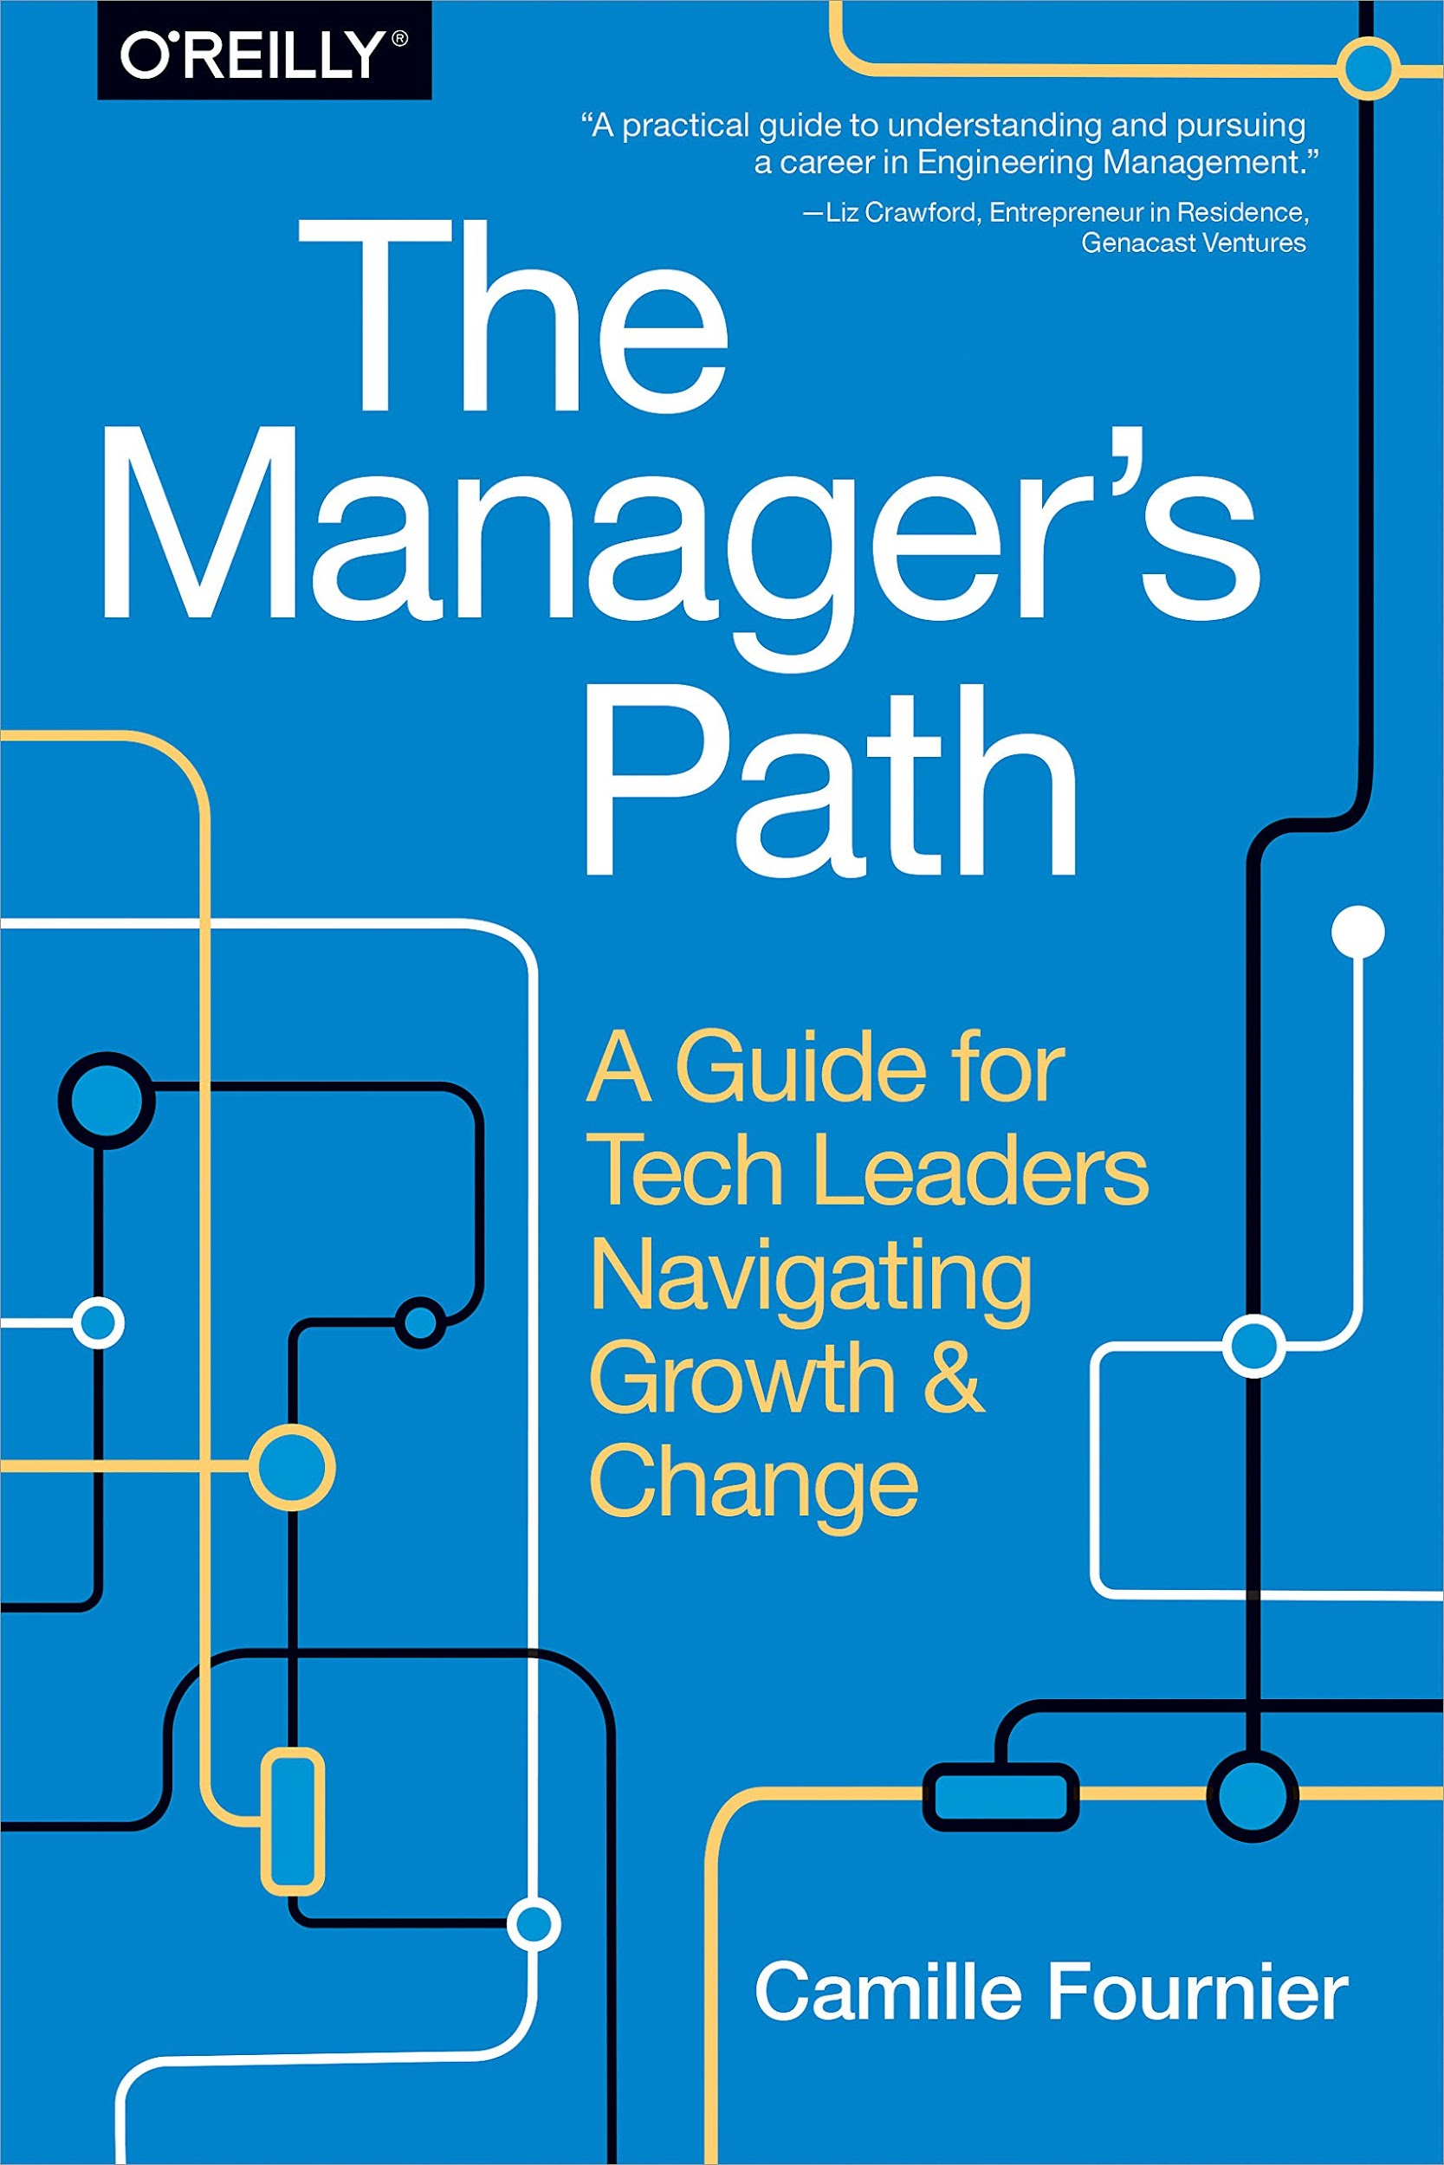
Full response: jackhumphrey.me/lead
Notes:
I referenced Google’s writings about their manager research, which is available at rework.withgoogle.com, and the writing that Camile Fournier has done on navigating the journey from engineer to technical manager, in a book called The Manager’s Path.

Slide 10
How did I build my leadership style?
Notes:
As I reflected on my response, I started thinking about the underlying principles that came through in these tidbits of managerial wisdom, and how my own intuition and core values have guided me.
And I wondered, would anybody be interested in listening to me talk about this way of building a leadership style?

Slide 11
Where I’m coming from
Developing software for ~24 years ⅔ of that time here in Austin
¾ in management/leadership
http://jackhumphrey.me | @youknowjack
Notes:
A little bit more background on me: I’ve been working in software for about 24 years, 2/3s of that in Austin, 3/4s of that time in management and leadership roles.

Slide 12

Notes:
For the last 10 years, I’ve been at Indeed years, where I’ve had the opportunity to coach a number of talented colleagues as they’ve moved into leadership. I’m proud of the leadership culture we’ve developed over that time.

Slide 13
Disclaimers
(not apologies)
Notes:
Before I go on, I want to offer a few disclaimers. These are not apologies, because I’ve been taught that you should never start a talk with apologies.
If you think they are unnecessary, I’m sorry. ;)

Slide 14

I love books.
They are an an amazing medium for spreading ideas and changing the world.
BOOKS ARE AWESOME
@youknowjack
Notes:
I called this talk “I Don’t Read Books” — but not because I have anything against books.
I love books. Growing up I was an enormous bookworm. Books were my gateway to imagining a future for myself. They are an incredible medium for spreading ideas and inspiring the world.
But when it comes to leadership, reading advice and theories was not how I shaped myself as a manager

Slide 15
White
Male
Cisgender
Raised in comfort
College-educated
etc.
CHECKING
PRIVILEGE
@youknowjack
Notes:
I think it’s pretty important that I check my privilege. I’m going to be sharing a little about my journey as a leader, and so I think it’s worth acknowledge all the privileges that have been on my side in life. I’m white, I’m cisgender male, I was raised in with plenty of resources available, and I got to go to college. To name a few. I bring these up to acknowledge that I haven’t had to face many challenges that others must overcome in their journeys.

Slide 16
I’m here to share the principles that guide me. You should define your own.

Slide 17
There are many ways to be a good leader.
Some aspects of leadership come naturally to you.
Others require work.
Notes:
Why does this matter? Because there are many ways to be a good leader. It’s not one size fits all.
Even if you have a really strong idea of the leader you want to be -- some things will come naturally, and some things won’t.

Slide 18
To define your own guiding principles,
first try to understand yourself.
Notes:
In order to define your principles, and know where you’ll have to put in the work, you need to understand yourself.

Slide 19
Developing your leadership style
Inspirations
Aspirations
Motivations
Inclinations
@youknowjack
Notes:
Here’s a framework that might help you do that. I suggest you consider your inspirations, your aspirations, your motivations, and your inclinations.
I think this is a really good framework, because, you know, it rhymes.

Slide 20
Inspirations
Aspirations
Motivations
Inclinations
What do you see that gives you the urge to do something?
Which leaders inspire you?
@youknowjack

Slide 21
My Inspirations
Aspirations
Motivations
Inclinations
People solving difficult problems in novel ways
People creating things that elevate us
Leaders who are authentic, humble, and passionate
@youknowjack

Slide 22
Inspirations
Aspirations
Motivations
Inclinations
What do you hope to achieve in life?
How do you want to lead others?
@youknowjack

Slide 23
Inspirations
My Aspirations
Motivations
Inclinations
Help others achieve their goals
Do work that matters
@youknowjack

Slide 24
Inspirations
Aspirations
Motivations
Inclinations
What activities give you energy?
Which parts of leadership do you love?
@youknowjack

Slide 25
Inspirations
Aspirations
My Motivations
Inclinations
Working together to accomplish a shared goal
Helping other people grow and succeed
Receiving recognition from others
@youknowjack

Slide 26
Inspirations
Aspirations
Motivations
Inclinations
What are your natural tendencies? What’s your default leadership style?
@youknowjack
Notes:
Your inclinations can either help or hinder you.

Slide 27
Inspirations
Aspirations
Motivations
My Inclinations
Solve problems
Learn about people and what makes them tick
Rarely open up or ask for help
“Hope for the best, expect the worst"
@youknowjack

Slide 28
Derive your guiding principles
Inspirations
Aspirations
Motivations
Inclinations
@youknowjack
Notes:
Use your inspirations, aspirations, motivations, and inclinations to think about the kind of leadership you want to be and can be. From there, you’ll start to see clearly the values you want to apply, and you should write them down.

Slide 29

Don’t Go It Solo
“
...you then need someone who helps you dig into which of the things you believe about yourself are really true, and which are stories you’re telling yourself.”
Camille Fournier
Managing Director, Two Sigma
Former CTO, Rent The Runway
“I hate manager READMEs” (Medium, 11/21/2018)
@youknowjack
Notes:
But here’s some wisdom from a recent piece by Camille Fournier. The context was a little different, because she’s talking about the dangers of manager READMEs, but the point is the same. You can do self-analysis, but “you then need someone…” It’s a great idea to work with a coach to do this digging, ideally someone you don’t report to.

Slide 30
Caring
Curiosity
MY GUIDING PRINCIPLES
Humility
Creativity
Trust
Optimism
@youknowjack
Notes:
Here are some of my top guiding principles: Caring, Humility, Trust, Curiosity, Creativity, and Optimism.

Slide 31
I use these principles to guide me.
How will a new technique help me live those principles?
Notes:
Once you’ve written them down, think about which ones will be easy, because they line up with your conscious aspirations, your motivations, and the inclinations that the skills that come naturally to you. And think about the ones that will be hard, because maybe they don’t come naturally.
Bring these principles with you as consciously as possible to your work. And as you hear or read advice, or see others model behaviors you could emulate, compare them to those values. Embrace the behaviors and techniques that match, disregard the others.
Sometimes this will feel like intuition, a gut check if you will, and sometimes it might need to be a more objective evaluation -- how will following this advice support your guiding principles?

Slide 32
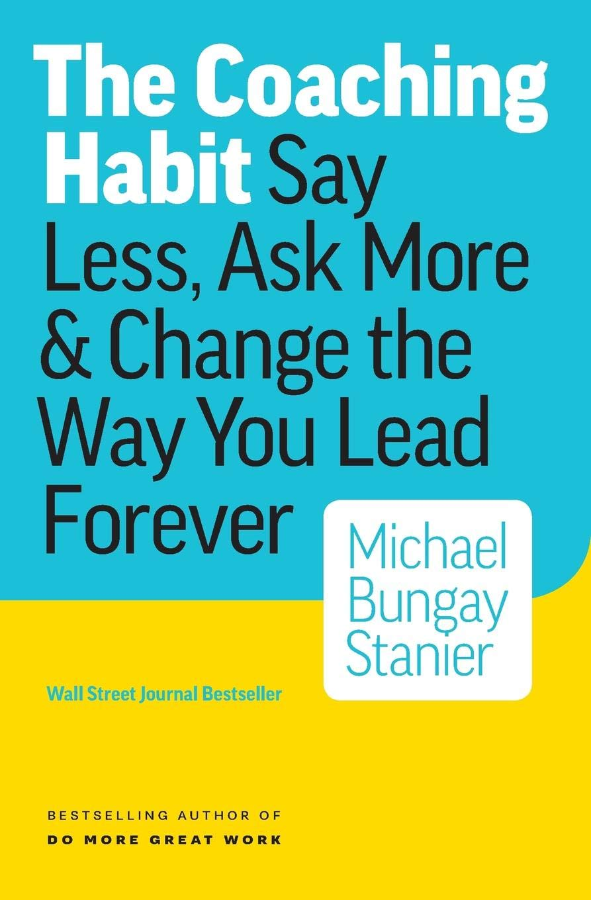
Asking More Questions
“
If this were a haiku rather than a book, it would read:
Tell less and ask more.
Your advice is not as good
As you think it is.”
Michael Bungay Stanier
The Coaching Habit (2016), p. 59
@youknowjack
Notes:
Take the advice that managers should seek to understand before being understood. That they should ask questions. Central point of this great book, The Coaching Habit, by Michael B. Stanier.
I really like Stanier’s advice. It fits well with most of my principles. Let’s look at a few.

Slide 33
Asking More Questions
Caring
Curiosity
Humility
Creativity
Trust
Optimism
@youknowjack
Notes:
Curiosity: What is the other person thinking? How do they see the situation?

Slide 34
Asking More Questions
Caring
Curiosity
Humility
Creativity
Trust
Optimism
@youknowjack
Notes:
Humility: Acknowledging implicitly that you don’t have all the answers.

Slide 35
Asking More Questions
Caring
Curiosity
Humility
Creativity
Trust
Optimism
@youknowjack
Notes:
Trust: Showing you trust them to think through things and find good solutions. And having them trust you enough to answer honestly and openly.

Slide 36
Asking More Questions
Caring
Curiosity
Humility
Creativity
Trust
Optimism
@youknowjack
Notes:
Optimism: Believing that a guided two-way dialog will produce better results; that people can surprise you and rise to new levels you might not expect.
That’s one example. I’ve found that by bringing these values into my own evolving approaches to management and leadership, I’ve found my way into many of the techniques that I later see people writing about.

Slide 37
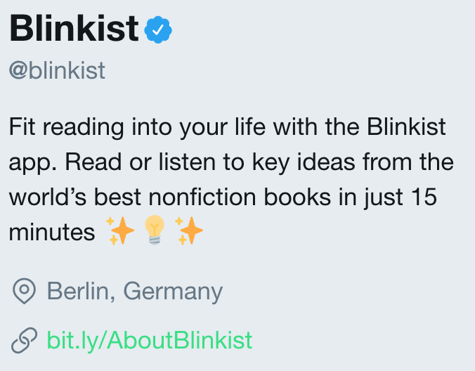
@youknowjack
Notes:
Quick aside: I actually got the key ideas from The Coaching Habit using a service called Blinkist. Their app allows you to get summaries of the key ideas from all kinds of nonfiction books. I’m not being paid to promote them, I’m just genuinely a big fan. Check them out.

Slide 38
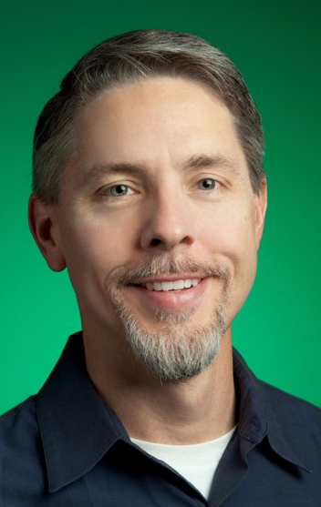
Inspiring Leadership
Some time ~2006, in the Googleplex
1st project review with Jeff Huber
He already knew everything.
He asked really helpful questions.
Jeff Huber
Founding CEO & Vice Chairman of GRAIL
Formerly Senior VP of Google Ads, Apps, Maps
@youknowjack
Notes:
As another example that’s more about a role model than advice, I had the opportunity to work (indirectly) for Jeff Huber when I was an engineering manager at Google. The first time I went in for a status review of my projects with Jeff, I was blown away by how much context he had for our projects (he was responsible at the time for dozens if not hundreds) and what good, helpful questions he asked.
What Jeff was showing in that meeting resonated with me.

Slide 39
Inspiring Leadership
Caring
Curiosity
Humility
Creativity
Trust
Optimism
@youknowjack
Notes:
Caring: Jeff showed me he cared about what my teams were working on and how it connected to a broader mission.

Slide 40
Inspiring Leadership
Caring
Curiosity
Humility
Creativity
Trust
Optimism
@youknowjack
Notes:
Humility: By asking questions instead of stating opinions or giving advice, he showed that he did not believe he knew better than the teams how to accomplish our goals.

Slide 41
Inspiring Leadership
Caring
Curiosity
Humility
Creativity
Trust
Optimism
@youknowjack
Notes:
Trust: Realizing that he knew so much about our projects but had given us complete autonomy made me feel trusted.
I remember walking out of that meeting and thinking, that’s the kind of leader I want to be. It was a powerful moment in my career.

Slide 42
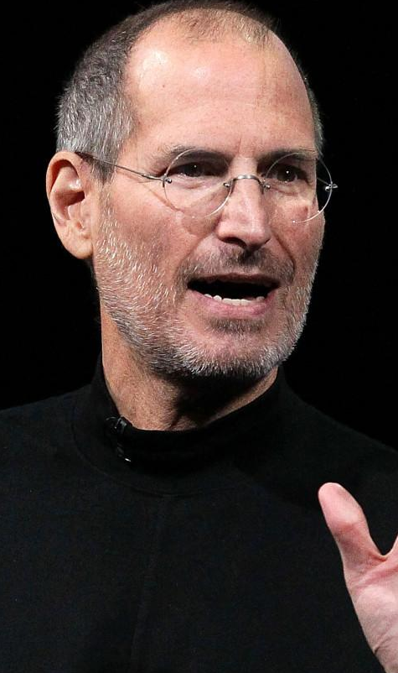

Repeat it ‘til you’re sick of it
“
In order to effectively communicate to an audience, you need to repeat yourself so often that you grow sick of hearing yourself say it, and only then will people begin to internalize the message.”
Jeff Weiner
CEO, LinkedIn
“Just Because You Said it, Doesn't Make it So” (2014)
@youknowjack
Notes:
As an example of something I’ve learned or changed recently: A few years back, Jeff Weiner wrote about really valuable advice a colleague gave him about the need to repeat your message. Jeff’s post reached me before this was an issue, and I filed it away. Later, as I struggled with why people in a large group in a growing company didn’t seem to be understanding things I thought were clear, I realized the value of this advice.
Which is basically, repeat yourself until you’re sick of saying it. And then repeat yourself some more. To reinforce Indeed’s culture, or explain a new strategic direction, I have to talk about it a lot.

Slide 43
Repeat it ‘til you’re sick of it
Caring
Curiosity
Humility
Creativity
Trust
Optimism
@youknowjack
Notes:
Caring: If you care about the people you’re trying to reach, you’ll be motivated to put the required effort in.

Slide 44
Repeat it ‘til you’re sick of it
Caring
Curiosity
Humility
Creativity
Trust
Optimism
@youknowjack
Notes:
Humility: Recognizing that regardless of your title or position, not everybody is tightly tuned in and hanging on your every word.

Slide 45
Repeat it ‘til you’re sick of it
Caring
Curiosity
Humility
Creativity
Trust
Optimism
@youknowjack
Notes:
There’s also an opportunity for creativity. How can you capture people’s attention, and how can you keep it interesting for yourself.

Slide 46
Identify your guiding principles.
Use them as a filter as you evolve your leadership style.
Embrace the behaviors and techniques that match your principles.
TAKEAWAYS
@youknowjack
Notes:
Think about your guiding principles. Or help people you coach think about theirs.
These principles are important as you evolve as a leader.
You can embrace the leadership techniques that match your principles, and ignore the ones don’t.

